Slide 1
Lab 2: Exploring Data with Graphical Displays and Numerical Summaries
Pre Lab
Shan Zhong

Slide 2


Slide 3
Categorical vs Quantitative Review
1. Categorical variables:
Each observation belongs to one of a set of distinct categories.
Yes/no response, gender, etc.
2. Quantitative variables:
Observations take on numerical values that represent different magnitudes of the variable.
Age, income, number of siblings.
Note that not all number responses are quantitative.
Ask yourself:
Does the number tell you how much of something?
If no then categorical.
If yes then quantitative.
Would the average of the numbers give a meaningful result?
If no then categorical.
If yes then quantitative.
Examples of numbers that are not quantitative: phone number, zip code, bank account numbers.

Slide 4
Types of Variables:
Discrete Quantitative – results are numbers that represent a count (“the number of …”).
Continuous Quantitative – results are numbers that represent a measurement.

Slide 5
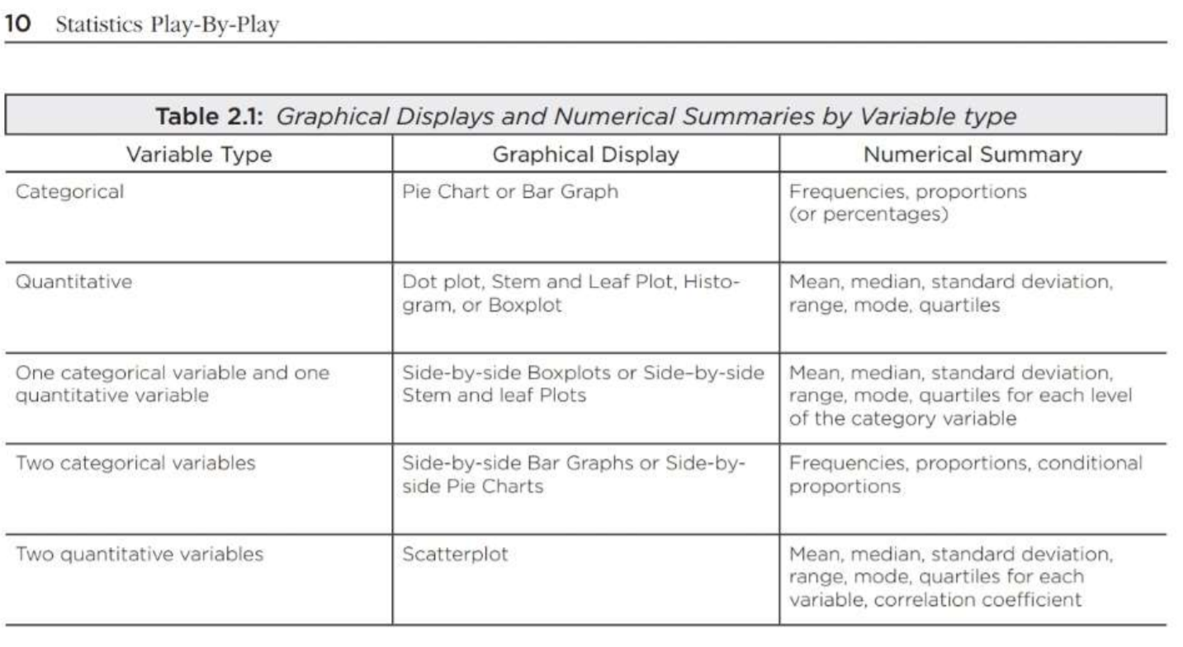
Graphical Displays and Numerical Summaries:
To determine which graphical displays and numerical summaries are appropriate for a variable reference Table 2.1 on page 10.

